Slide 1
电池全生命周期管理系统
结题汇报
Jun 7，2024
小组成员：王浩羽、李宗润、徐 涵
指导老师：卢周广、高 源、宋 轩
企业导师：袁 飞

Slide 2
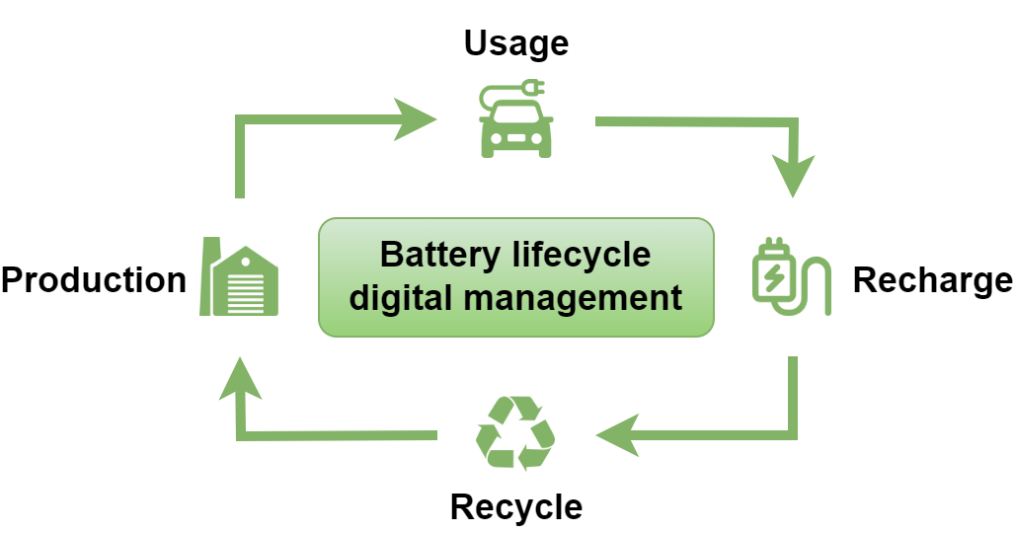

Background
Advantage：
Improve battery performance and safety
Provides support for the secondary utilization of batteries
Notes:
背景和意义的阐述需要清晰的说明项目的why的内容！为什么我们要做这个项目，基于哪些背景需求，解决了这些需求有什么意义，这些意义才是我们科研工作的研究价值。

Slide 3
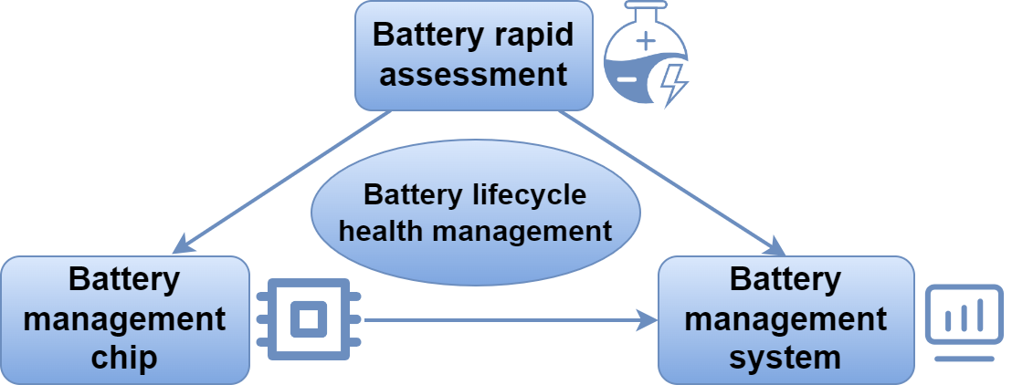
Background
材料科学与工程系
李宗润
深港微电子学院
徐涵
计算机科学与工程系
王浩羽
Notes:
背景和意义的阐述需要清晰的说明项目的why的内容！为什么我们要做这个项目，基于哪些背景需求，解决了这些需求有什么意义，这些意义才是我们科研工作的研究价值。

Slide 4
Part A: Materials Science
and Engineering
XXX
李宗润

Slide 5
Part B: School of
Microelectronics
XXX
徐涵

Slide 6
Part C: Computer Science
and Engineering
Goals and Objectives
Proposed Methods
Experimental Results
Conclusion
王浩羽

Slide 7
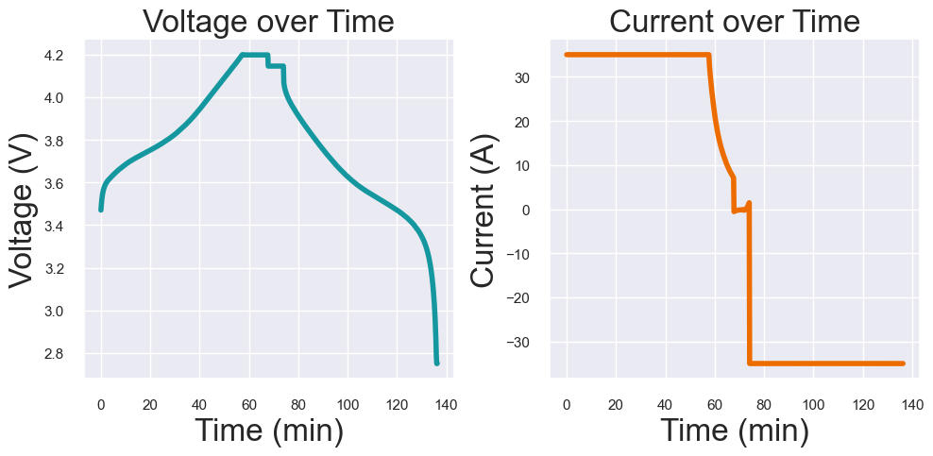
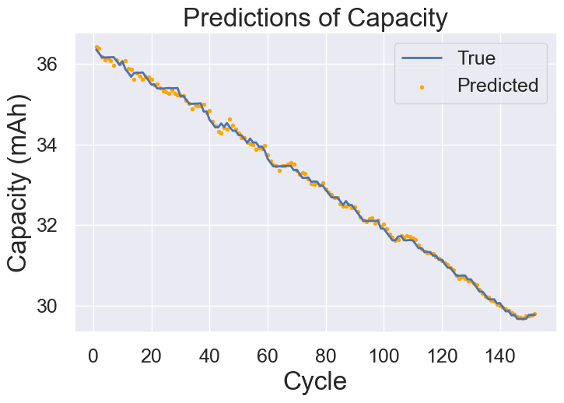
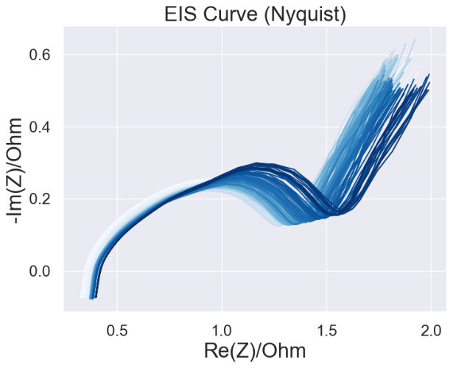
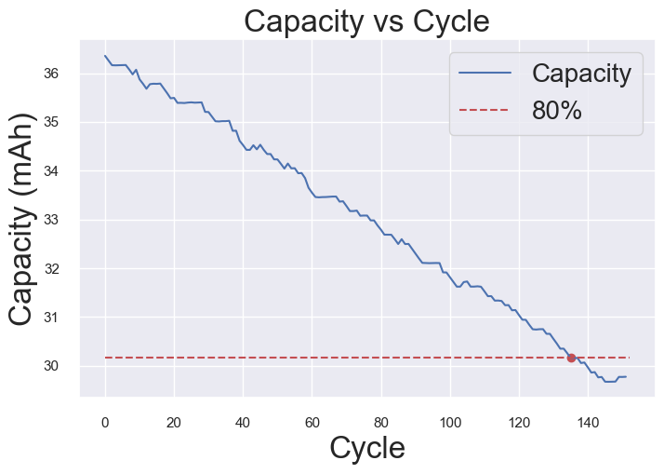
Goals and Objectives
Predict
Charging Curve
Capacity Degradation Curve
Estimate
EIS Profile
Remaining Useful Life (RUL)

Slide 8
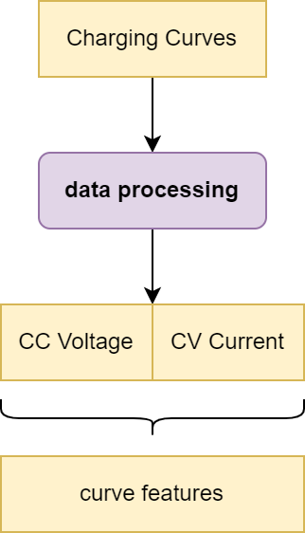
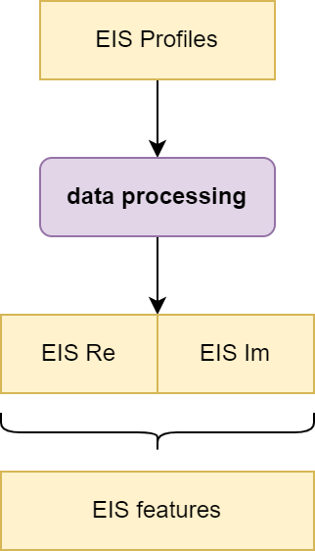
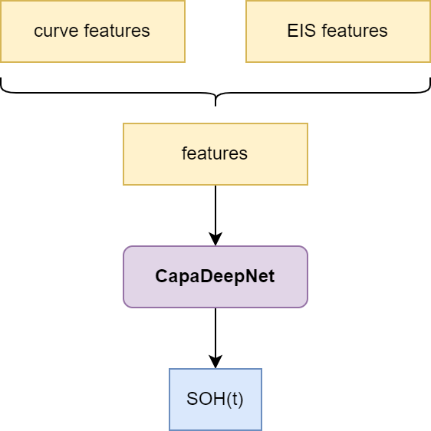
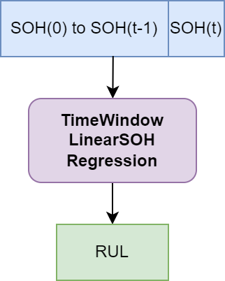
Proposed Methods
Step1
Data Processing
Step2
Predict Current Capacity
Calculate State of Health
(SOH)
Step3
Estimate
Remaining Useful Life
(RUL)

Slide 9
Proposed Methods
Step2: CapaDeepNet
Deep Neural Net for Battery Capacity Prediction
Hyper Params:
Epoch：50
Batch Size：16
DeepNet Structure:
 | layer | in-dim | out-dim
1 | FC | Feature-size | 32
2 | FC | 32 | 64
3 | FC | 64 | 72
4 | FC | 72 | 128
5 | FC | 128 | 64
6 | FC | 64 | 64
7 | FC | 64 | 32
8 | FC | 32 | 16
9 | FC | 16 | 8
10 | FC | 8 | 1

Slide 10
Dataset 1: 18650
Dataset 1 (Self-measuring):
6 Batteries of “18650”
Only Charging Curves but No EIS Profiles!
battery | charging protocol | CC current | CV voltage | cycle
1 | CC-CV | 2.0A | 4.2V | 859
2 | CC-CV | 2.0A | 4.2V | 869
3 | CC-CV | 2.0A | 4.2V | 900
4 | CC-CV | 3.0A | 4.2V | 894
5 | CC-CV | 3.0A | 4.2V | 844
6 | CC-CV | 3.0A | 4.2V | 920

Slide 11
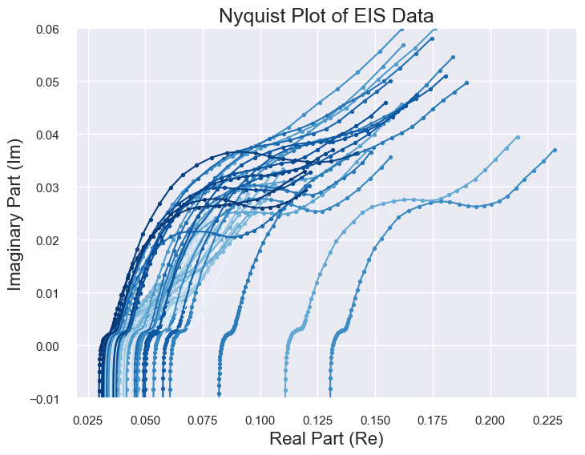
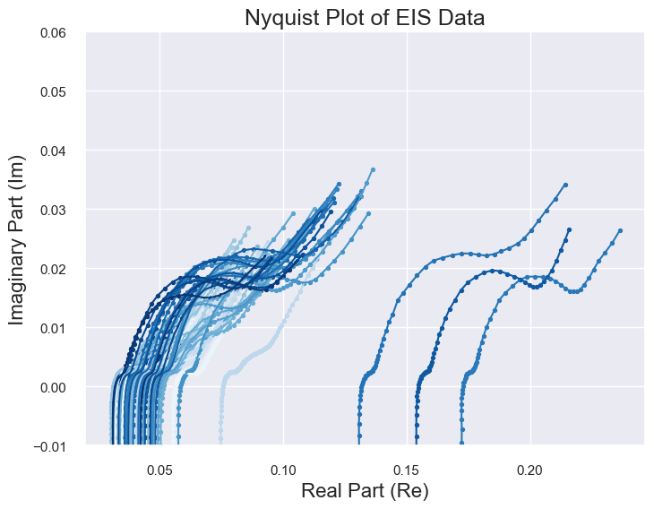
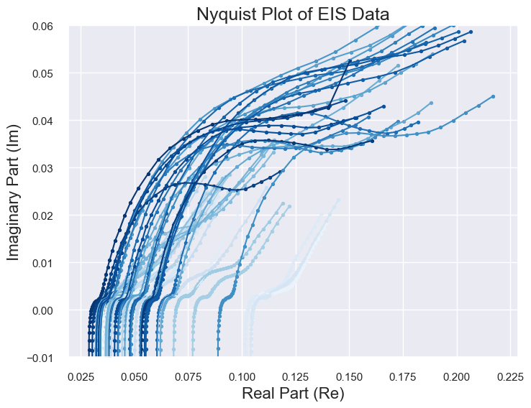
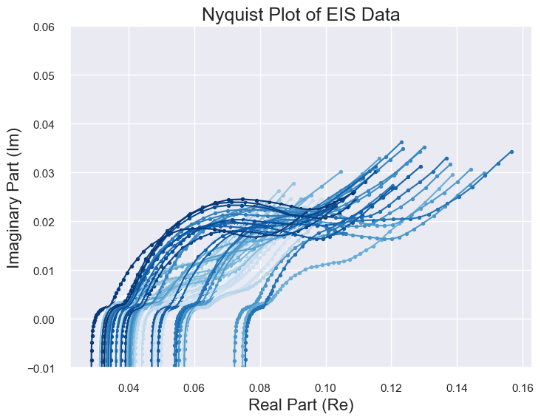
Dataset 1: 18650
EIS Profiles:
Can NOT Use due to
the INSTRUMENTs

Slide 12
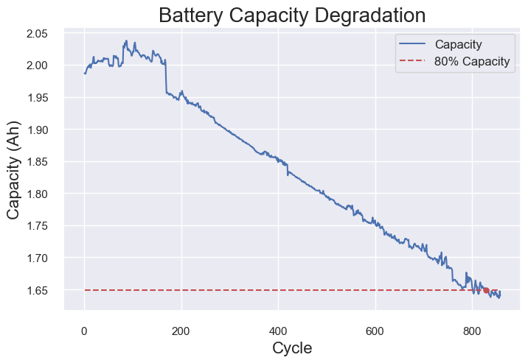
Dataset 1: 18650
Data in Dataset (Battery 1):
Battery Charging Curves
(1 cycle)
Capacity Degradation Curve

Slide 13
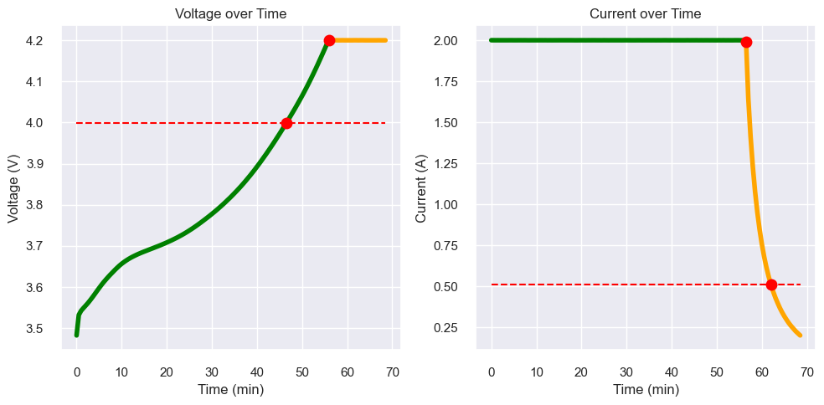
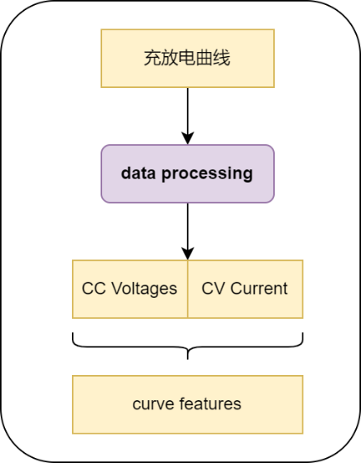
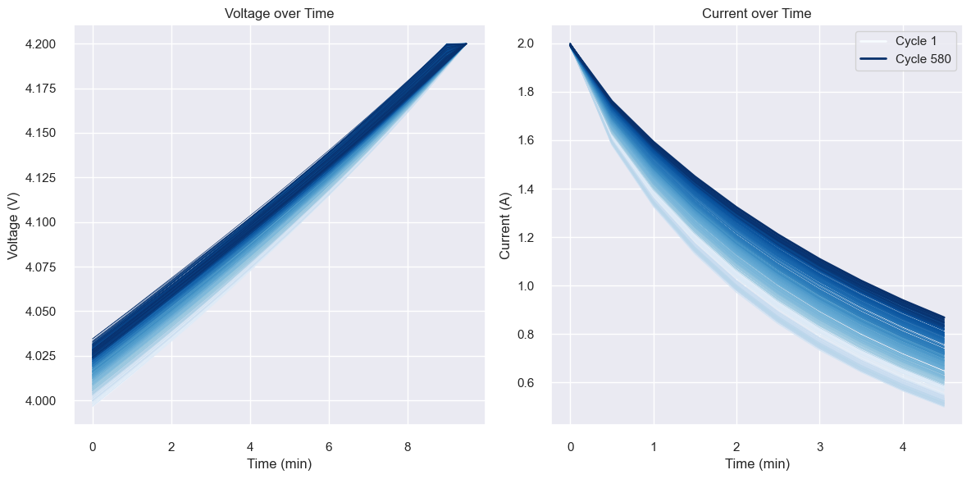
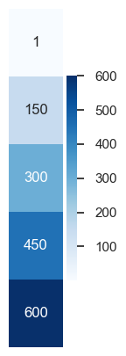
Dataset 1: 18650
Step1: Data Processing
CC Voltage
CV Current
CC
Voltage
Sample points number
CC -> U: 4.0V ~ 4.2V; I=2.0A
CV -> I: 2.0A ~ 0.5A; U=4.2V
Sample points number
CC Voltage: 20
CV Current: 10
CV Current

Slide 14
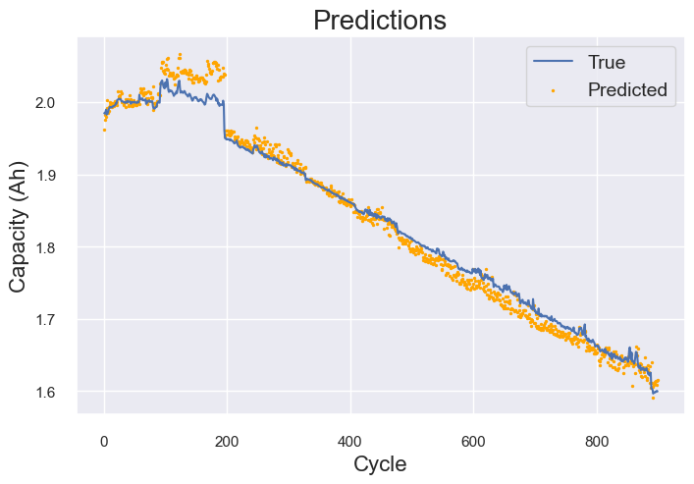
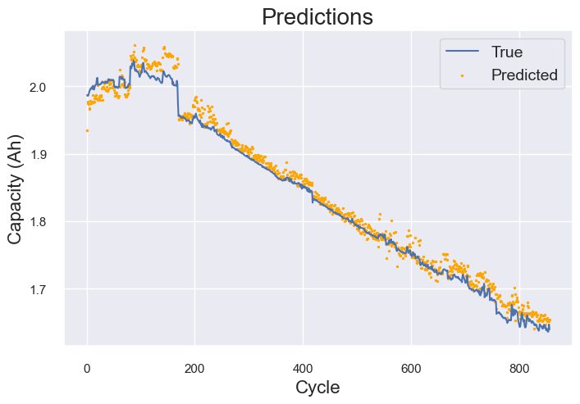
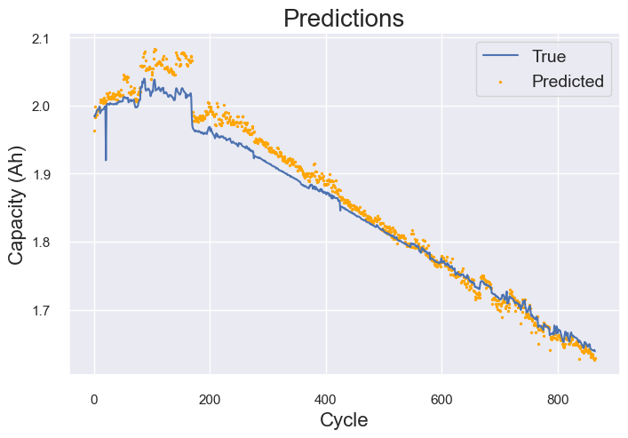
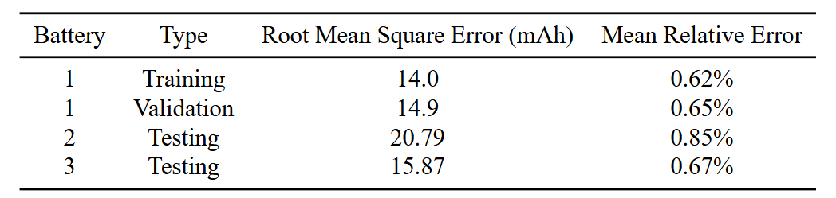
Dataset 1: 18650 – Capacity Prediction
Step2: CapaDeepNet
Battery 1: Training Data
(training and validation)
Battery 2 and 3: Evaluation

Slide 15
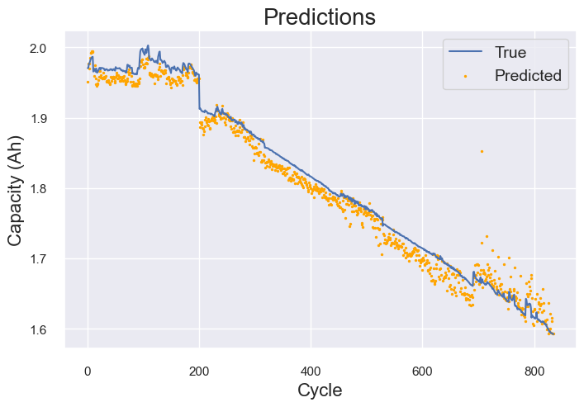
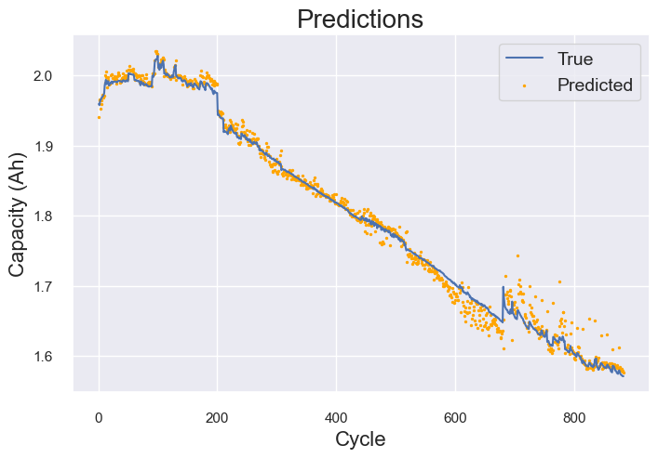
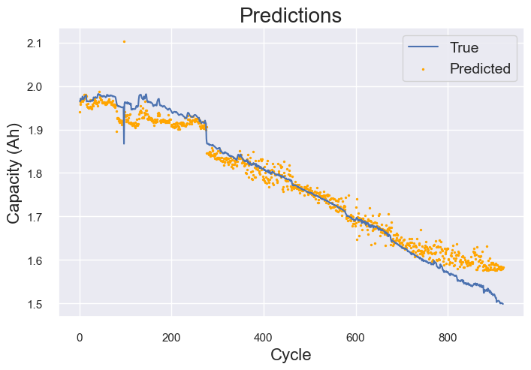
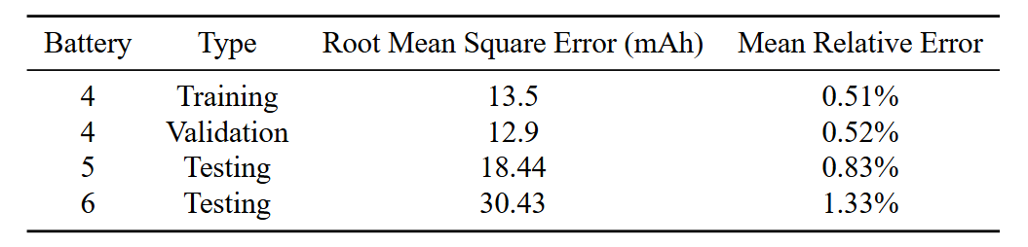
Dataset 1: 18650 – Capacity Prediction
Step2: CapaDeepNet
Battery 4: Training Data
(training and validation)
Battery 5 and 6: Evaluation

Slide 16
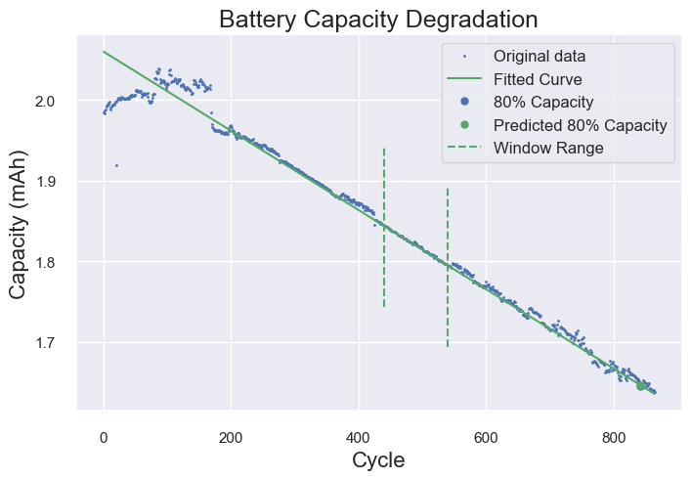
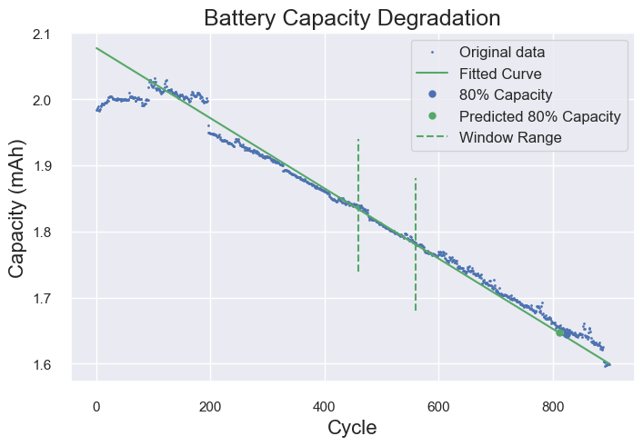
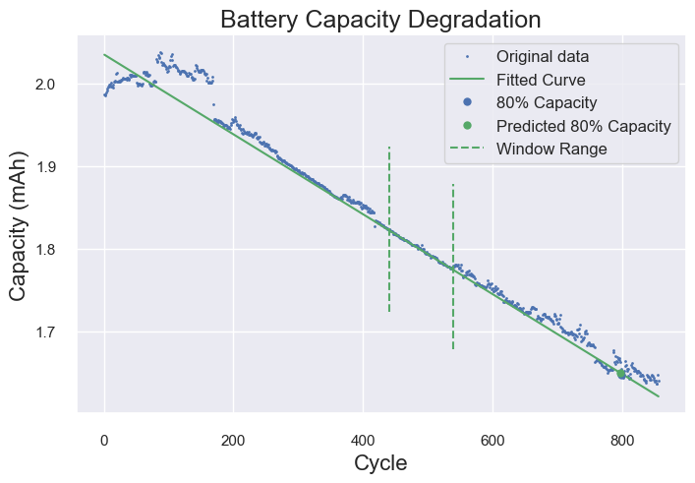
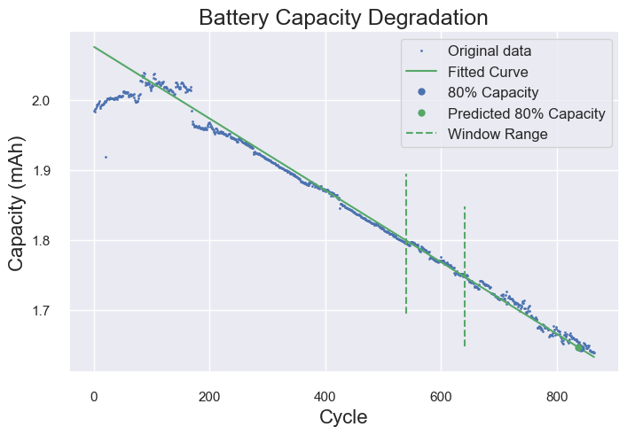
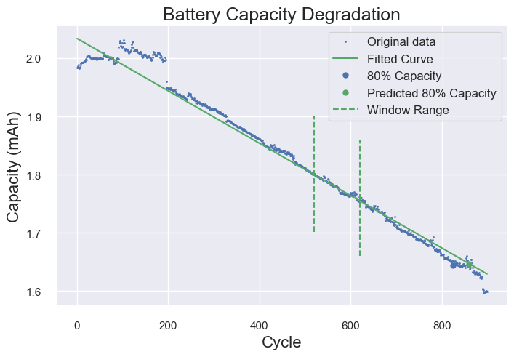

Dataset 1: 18650 – RUL Estimation
Step3: Time-window Linear Regression
Time-window
440-540 cycles
540-640 cycles
Battery 1
Battery 2
Battery 3

Slide 17
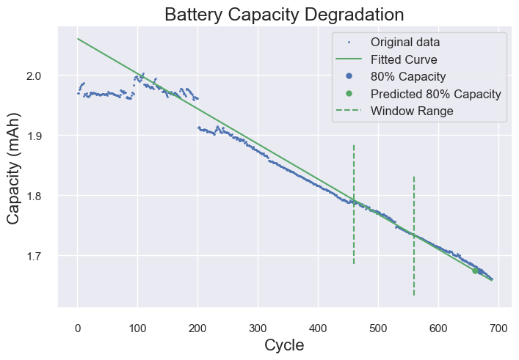
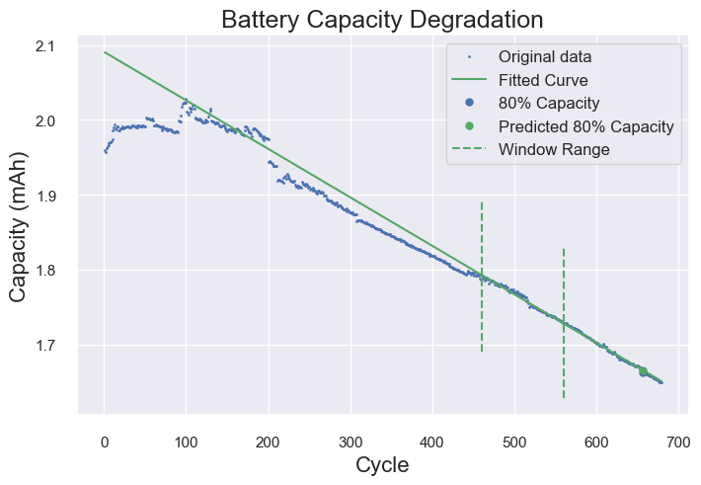
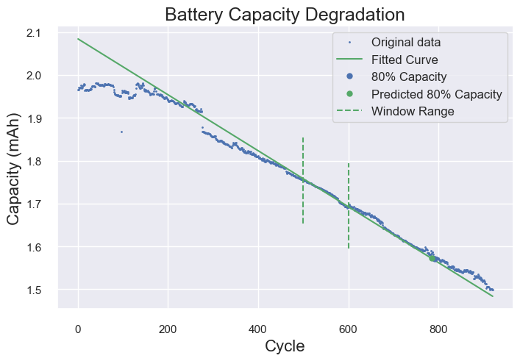
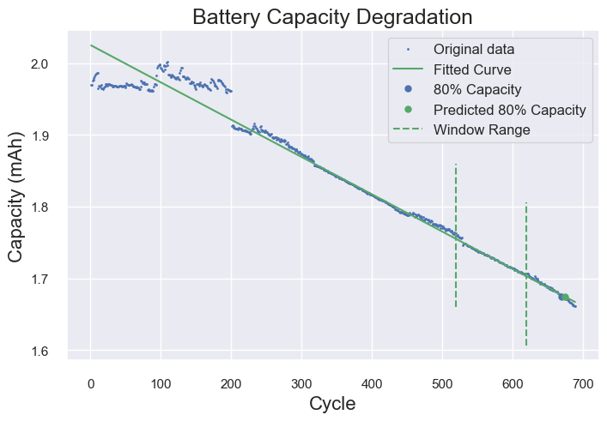
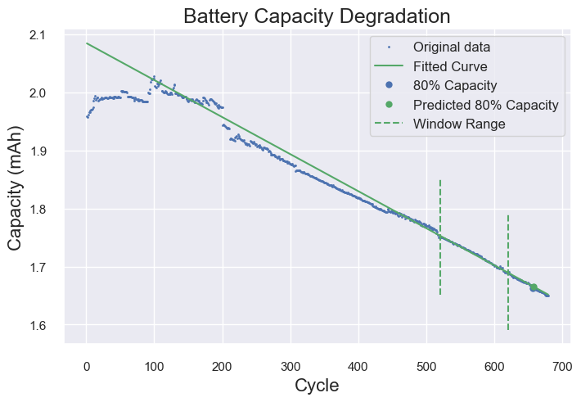
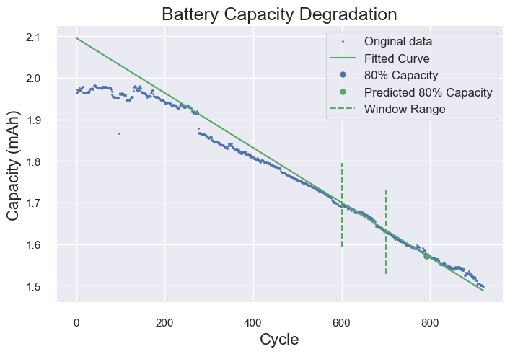
Dataset 1: 18650 – RUL Estimation
Step3: Time-window Linear Regression
Time-window
460-560 cycles
520-620 cycles
Battery 4
Battery 5
Battery 6

Slide 18
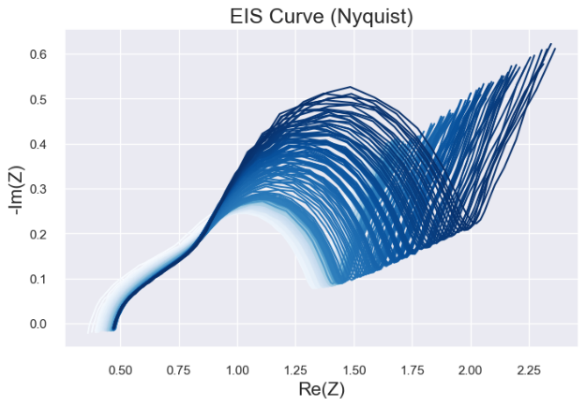
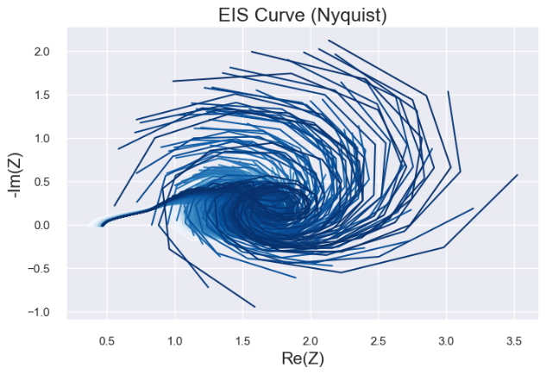
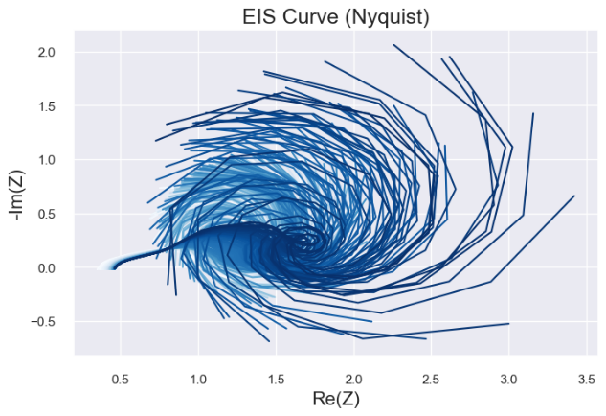
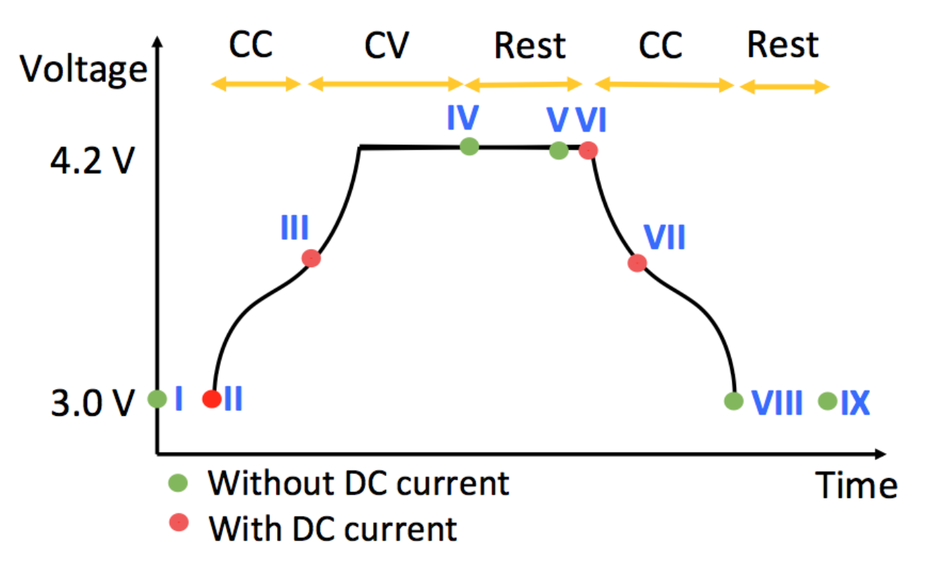
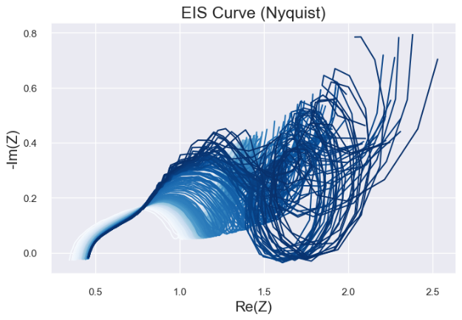
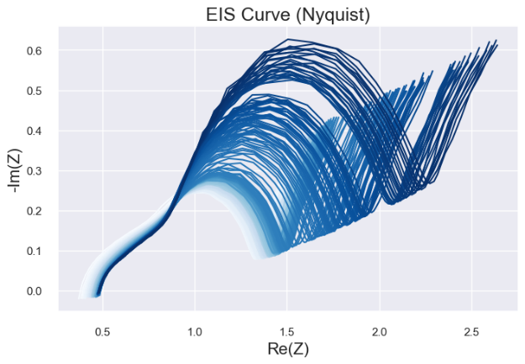
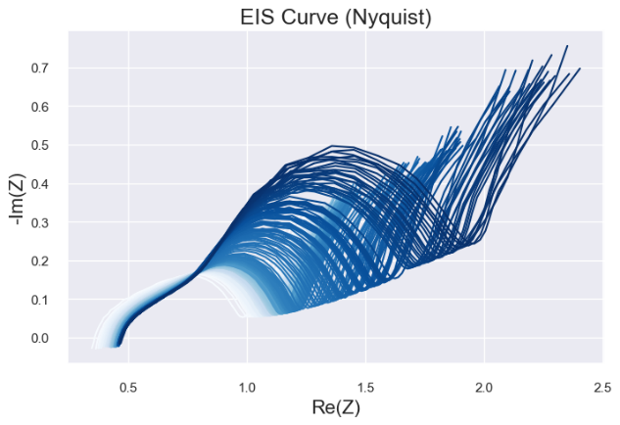
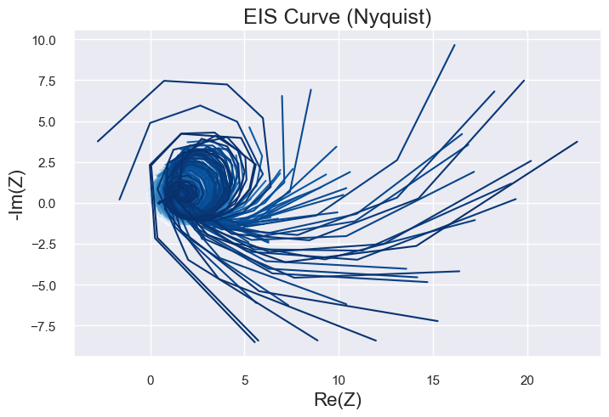
Dataset 2: 3633835
https://zenodo.org/records/3633835
Choose Battery: 25C05
(from 8 batteries)
Choose state V
Open-source; EIS Only
I
II
III
IV
V
VI
IX
Data source: Identifying degradation patterns of lithium ion batteries from impedance spectroscopy using machine learning
https://zenodo.org/records/3633835

Slide 19
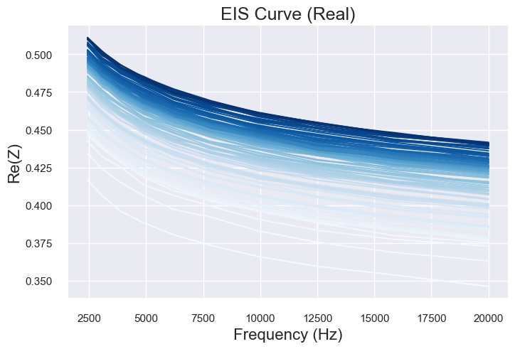
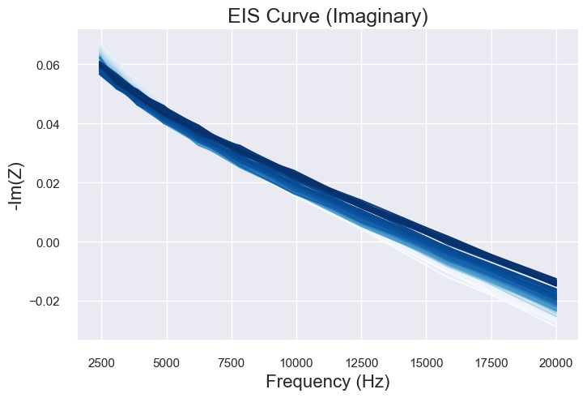
Dataset 2: 3633835 – Capacity Prediction (Interval)
Choose Battery: 25C05
EIS Features (Method 1): Interval of Re/Im Segments
EIS Features
(for all cycles)

Slide 20
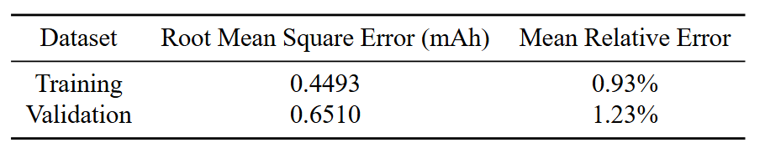
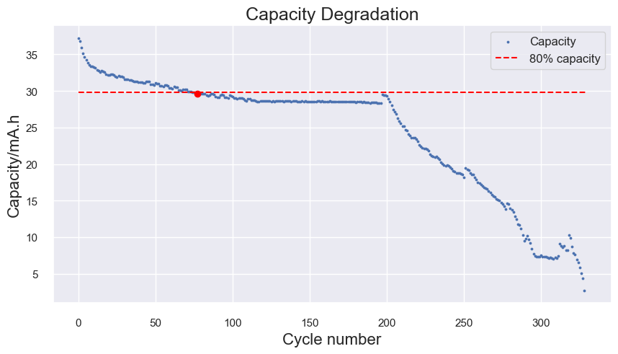

Dataset 2: 3633835 – Capacity Prediction (Interval)
Step2: CapaDNN
Capacity Degradation Curve
Prediction results

Slide 21


Dataset 2: 3633835 – Capacity Prediction (Characters)
Choose Battery: 25C05
EIS Features (Method 2): EIS Characters
EIS Characters
(for 1 cycle)
EIS Features
(for all cycles)

Slide 22

Dataset 2: 3633835 – Capacity Prediction (Characters)
Step2: CapaDNN
0.4308
0.91%
0.3170
0.78%
Capacity Degradation Curve
Prediction results

Slide 23
Dataset 2: 3633835 – Comparison
Step2: CapaDNN:
Mean Relative Error:
1.23% =====>>>>>> 0.78%
Method1: Interval
Method2: Characters

Slide 24





Dataset 2: 3633835 – RUL Estimation
Step 3:
Time-window Linear Regression
40–60 cycles
50–70 cycles
Model shows a poor Robustness!
60–80 cycles
70–90 cycles

Slide 25


Dataset 3: Button Cell
Self-measuring
Single Battery Only
Capacity Degradation Curve
EIS Profile

Slide 26


Dataset 3: Button Cell
Features
Charging Curve
Features
(for all cycles)
EIS Features
(for all cycles)

Slide 27







Dataset 3: Button Cell - Results
Step 3: Time-window Linear Regression
Step2: CapaDNN

Slide 28








Dataset 4: NASA (Deprecated)
Totally Ridiculous!
EIS Profiles for Several Batteries

Slide 29
Conclusion
To enhance the Accuracy and Applicability of our model,
For CapaDNN:
Good enough for LAB datasets
Collect more realistic data from REAL USAGE
For Time-window Linear Regression:
Effective for some cases
Poor Robustness
Sensitive to Abnormal value

Slide 30
Reference
1．Wang, S., Jin, S., Bai, D., Fan, Y., Shi, H., & Fernandez, C. (2021). A critical review of improved deep learning methods for the remaining useful life prediction of lithium-ion batteries. Energy Reports, 7, 5562–5574. https://doi.org/10.1016/j.egyr.2021.08.182
2．Ansari, S., Ayob, A., Hossain Lipu, M. S., Hussain, A., & Saad, M. H. M. (2022). Remaining useful life prediction for lithium-ion battery storage system: A comprehensive review of methods, key factors, issues and future outlook. Energy Reports, 8, 12153–12185. https://doi.org/10.1016/j.egyr.2022.09.043
3．Wang, S., Jin, S., Deng, D., & Fernandez, C. (2021). A Critical Review of Online Battery Remaining Useful Lifetime Prediction Methods. Frontiers in Mechanical Engineering, 7. https://doi.org/10.3389/fmech.2021.719718
4．Park, K., Choi, Y., Choi, W. J., Ryu, H.-Y., & Kim, H. (2020). LSTM-Based Battery Remaining Useful Life Prediction With Multi-Channel Charging Profiles. IEEE Access, 8, 20786–20798. https://doi.org/10.1109/access.2020.2968939
5．Xu, Q., Wu, M., Khoo, E., Chen, Z., & Li, X. (2023). A Hybrid Ensemble Deep Learning Approach for Early Prediction of Battery Remaining Useful Life. IEEE/CAA Journal of Automatica Sinica, 10(1), 177–187.
https://doi.org/10.1109/jas.2023.123024
6．Lu, J., Xiong, R., Tian, J., Wang, C., & Sun, F. (2023). Deep learning to estimate lithium-ion battery state of health without additional degradation experiments. Nature Communications, 14(1). https://doi.org/10.1038/s41467-023-38458-w
7．Zhang, Y., Tang, Q., Zhang, Y., Wang, J., Stimming, U., & Lee, A. A. (2020). Identifying degradation patterns of lithium ion batteries from impedance spectroscopy using machine learning. Nature Communications, 11(1). https://doi.org/10.1038/s41467-020-15235-7

Slide 31
THANK YOU！

Slide 32








3633835 dataset
Capacity Degradation Curves
For 8 Batteries

